Slide 1
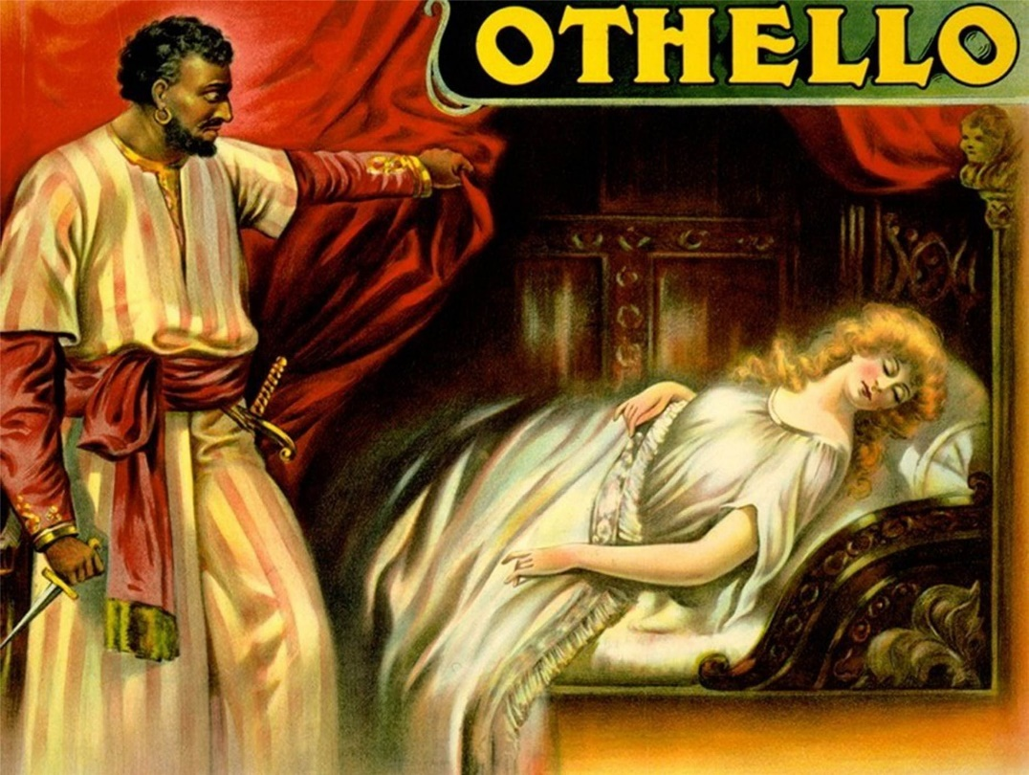
Othello
Name
Institution

Slide 2
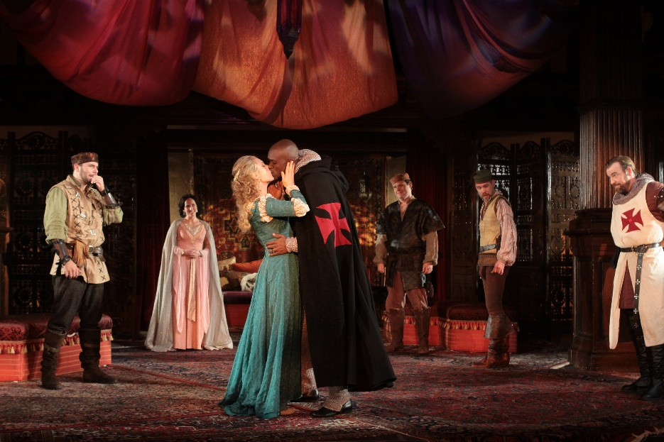
Description of the main characters
Othello- He is the main character in the play.
He is a hero and a leader of the militaries.
He is physically robust and respected by the people around him.
Desdemona- She is the daughter of a senator and is married to Othello before the start of the play.
She is the main female character.
Iago- acts as the major antagonist.
He gets a promotion from Othello
Casio- He represents real character and is a respected officer.
Emilia- She is Iago’s wife, and portrays loyalty by remaining faithful to her husband.

Slide 3
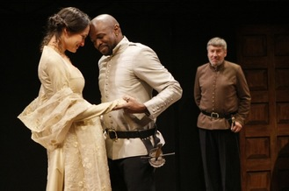
Othello Themes
Race- Othello is a black man, and according to English literature, he is the first black hero.
The relationship between Othello and Desdemona portrays an interracial marriage.
Iago mocks Othello due to his race, and at some point, Othello feels not good enough.
Jealousy- The entire story is propelled by jealousy feelings.
Iago is not happy when Casio is appointed.
Roderigo is envious Othello because of his marriage with Desdemona.
Duplicity- Othello trusts Iago, not knowing that his character was not perfect.
Othello ends up failing in his duties due to the mistake of judgment.

Slide 4
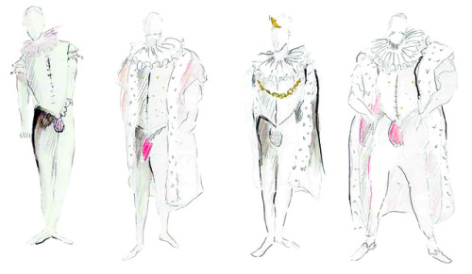
Costumes in Othello
Costumes used by the characters play a vital role in the production.
Most outfits are used to define the roles of different individuals.
Some costumes are worn to describe certain themes in the play.
They also explain the time and period of different events.
Othello wears a luxurious costume to show his position as a general of Venice.
Considering the purchase and designing of the costumes and stage setting, the approximate budget is two thousand, five hundred dollars.

Slide 5
Lighting and sound
The sound effect is used when Emilia banged the door of her bedroom, Othello is surprised by the sound, though Emilia did not have a bad intention. The bang was deafening.
As soon as Othello falls after kissing his wife, lights come up and the cast scream in fear.
The stage setting is a sign of inner life for Othello and his wife.
Iago’s motives are not portrayed by the expressionistic techniques used on stage.

Slide 6
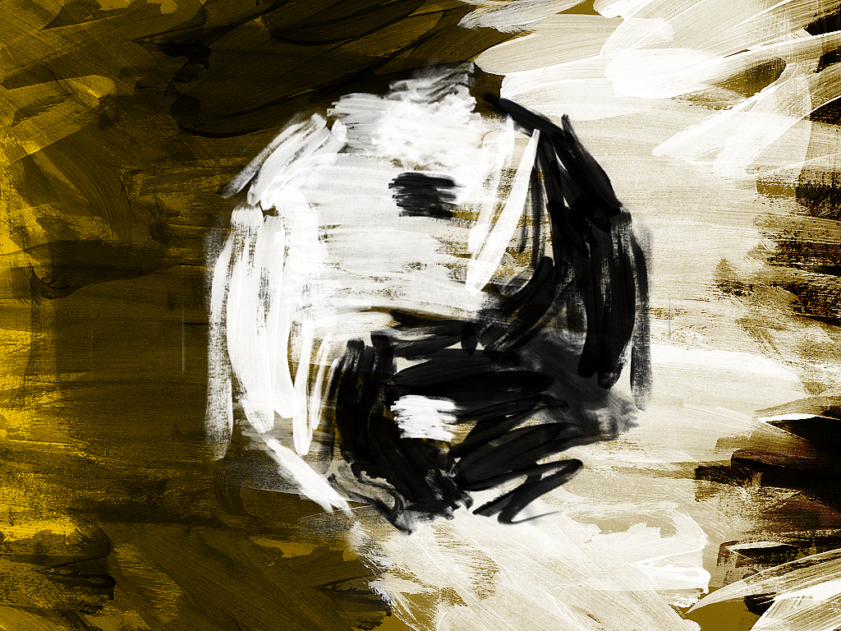
Use of light versus darkness in Othello
Light is seen in Othello’s interracial marriage, while darkness is portrayed by Iago’s jealous.
By the use of a metaphor, Barbantio shows that light is good, and he hopes to discover the truth through light. He uses the word oppress to show darkness.
From the start of the play, Iago is racial and uses the word black to show negative feelings (Liu, 2016).
Light and darkness are used to explain the theme of racism through Othello’s marriage.

Slide 7
References
Liu, X. (2016). INTERACTIVE VISUALISATION OF SHAKESPEARE’S OTHELLO.

